Slide 1
Data analysis of bank telemarketing
Dario Melconian
Soham ghose
Liu zezhen
sun chuwen

Slide 2
Dataset
Predictors include: age, job, marital, education, housing, loan, contact, month, duration,
Dataset of Portuguese Banking Institution involving direct marketing campaigns from 2008-2013.
From UCI Machine learning Rep., 40,000 rows, 20 variables.
Marketing campaigns performed by phone call. More than 1 method of contact often used, in order to determine if a client was to be subscribed to a “Bank Term Deposit” (‘yes’ or ‘no’).

Slide 3

Exploratory analysis
As duration increases, number of ‘yes’ increases.
Retirees, students, unemployed, or management position clients are more likely to sign up for long term deposit accounts

Slide 4
Main Data analysis
‘housing’
Blue is the same for each bar in the graph, showing the irrelevance of the housing variable, and for unknown, housing is a null value, not informative.
‘day_of_the_week’
Same idea for each bar, so the day is irrelevant for yes vs. no, and it is seen that the # of contacts are close , which shows that days do not influence the decision
*few other dropped variables for similar reasoning

Slide 5
Logistic regression model
n=β0 age + β1job + β2marital +β3 education + β4loan + β5month + β6duration + β7campaign + β8emp.var.rate
+ β9cons.price.idx + β10cons.conf.idx + β11euribor3m + β12nr.employed
This fit results in the following statistics:
Deviance = 17,608
Null Deviance = 28,997
Difference = 11,389
Chi-Squared for Nested Models like this model:
Drop variables one at a time, seeing if the model with the variable
is better than without the variable.
However, difference in deviance shows the absence of important
predictors that are not present in the dataset.
For predictors we do have, it does answer some questions.
AIC full model: 17,694
AIC final model: 17,685
predictor | Pr(>Chi)
job | 3.221e-07
education | 0.02797
month | 2.2e-16
duration | 2.2e-16
campaign | 3.924e-05
emp.var.rate | 2.2e-16
cons.price.idx | 2.2e-16
euribor3m | 1.471e-08
contact | 2.2e-16
Previous | 4.882e-07
cons.conf.idx | 6.441e-05

Slide 6
Significant coefficients & interpretations
Variable | Coefficient | Change in Odds
Duration | 4.71e-03 | 1.005
cons.conf.idx | 2.11e-02 | 1.021
jobstudent | 2.55e-01 | 1.29
Previous | 1.56e-01 | 1.169
1-minute increase in duration results in a 0.5% increase in the odds of a subscription.
1-unit increase in consumer confidence index results in a 2.1% increase in the odds of a subscription.
For student clients, odds of subscribing increase by 29%. This is in line with our initial hypothesis.
1-unit increase in the number of times a customer is contacted, there is a 16.9% increase in the odds.

Slide 7

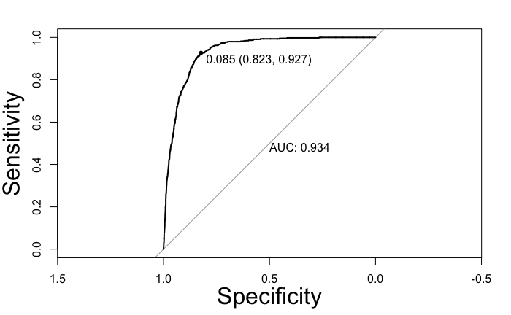
Model performance
AUC value is and model is successful in partitioning the response variable.
Surprising that optimal threshold is at 0.085, meaning that anything above 0.085 would be a ‘yes’
This is suspected to be because class distribution is very unbalanced (‘yes’ vs. ‘no’)

Slide 8
Classification table
Predicted Actual | Actual Yes | Actual No
Predicted Yes | 4336 | 6957
Predicted No | 304 | 29587
Tradeoff is acceptable because you would rather advertise to people that are not interested in the product than
Not advertise to people that are, in fact, interested.

Slide 9
Goodness of fit
J = 10 partitions, and the result did not change for a different J (5-20).
X²_{HL} = 571.12 produces an extremely low p-value, in a Chi-Squared distribution. High given the DF in the model.
The null hypothesis is that there is no lack of fit. P-value of 2.2x10⁻¹⁶ proves a rejection of the null, proving there is a lack of fit with our model.

Slide 10
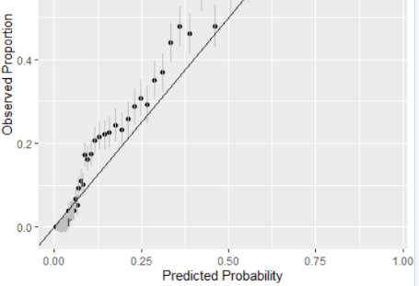
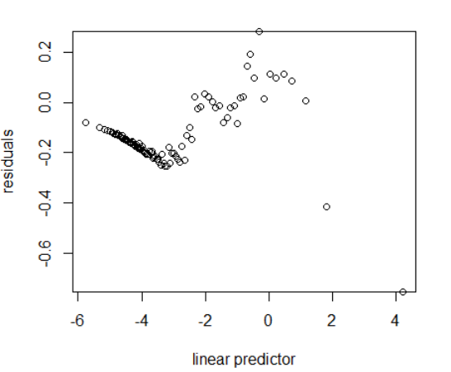
Conclusion
Predicted probability does not line up properly with the observed proportions.
Predictions are lower than the observed, which can be traced back to lack of a balanced class distribution.
Residuals are not even in their variance with respect to the linear predictor.
All of this justifies a model that does not correctly fit the data.
The analysis of this data did help us gain insight on important factors such as

Slide 11
Discussion
Omitted variable bias in the model.
Apply transformations to some predictors.
Better model choice; additive model.

